Slide 1
Welcome! MPages GAIA and FUSION
Brian Heits
Associate Lead Software Engineer
July 8, 2019

Slide 2

GAIA
MPages GAIA is a highly extensible development ecosystem streamlining the MPages development process.

Slide 3
GAIA
30 minutes or less to setup an MPages development environment.
Quick feedback cycle.
One-stop-shop for development tools.
Always current development ecosystem.
Developer focus on content and functionality.

Slide 4
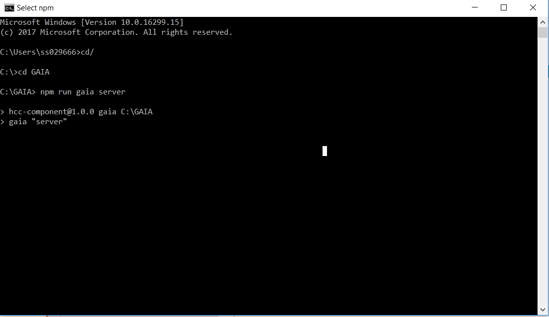
GAIA
Start the GAIA server

Slide 5
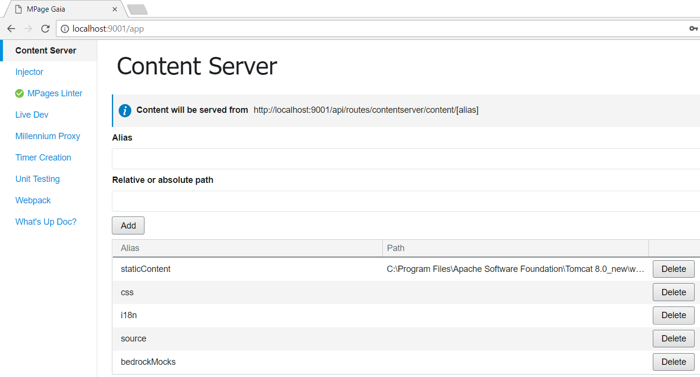
GAIA
Access GAIA via browser http://localhost:9001/app

Slide 6
GAIA – Linter Plugin
Uses ESLint to scan code for style errors.
Identifies potential bugs at compile time.

Slide 7
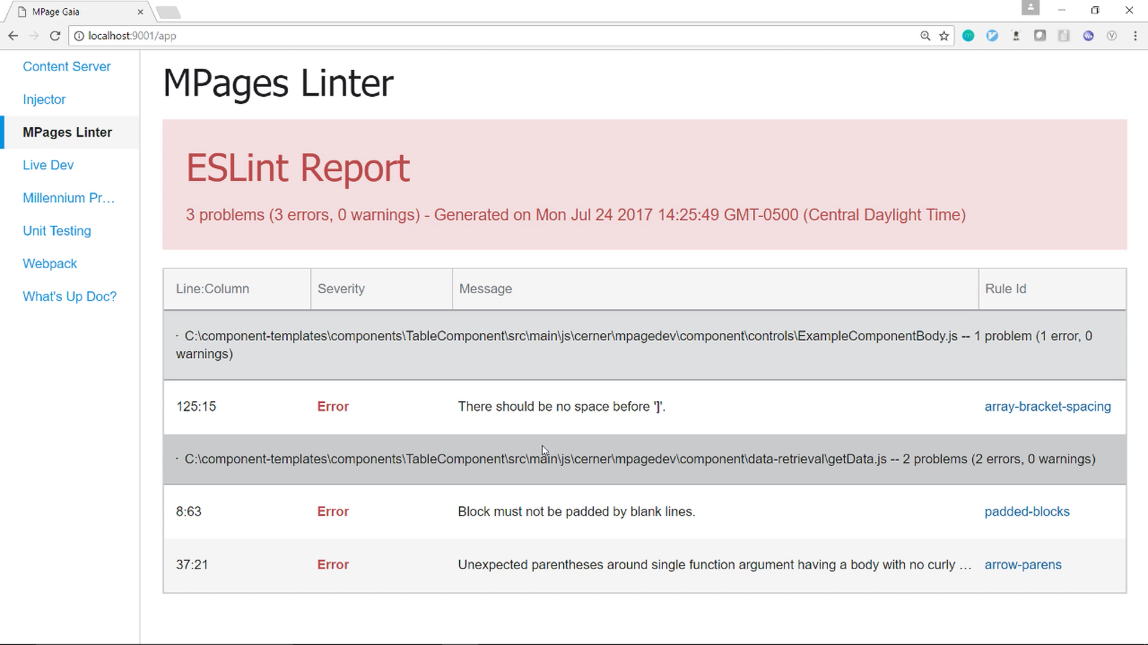
GAIA – Linter Plugin

Slide 8
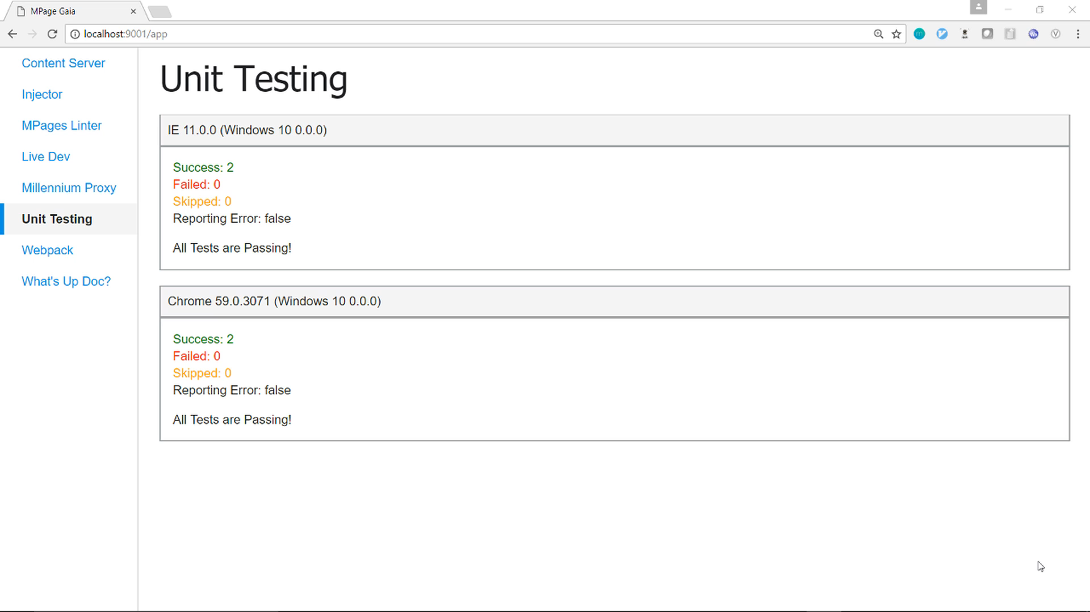
GAIA - Unit Testing

Slide 9
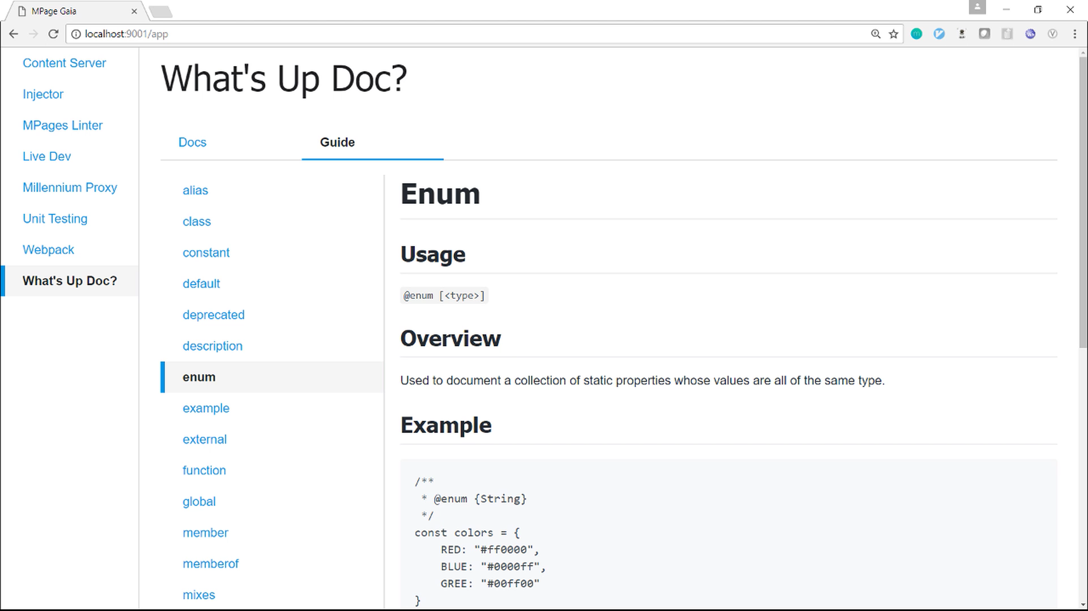
GAIA - JSDoc Plugin
Automatically generates documentation by reading code comments.

Slide 10
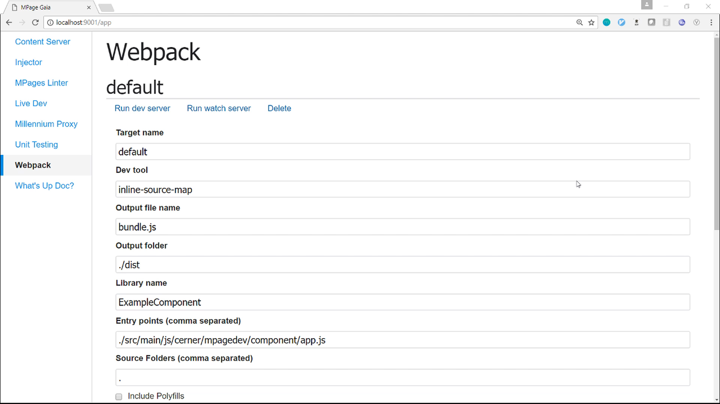
GAIA - Webpack Plugin
Allows compiling multiple files down to a single file.
Transforms ES6 to ES5.

Slide 11
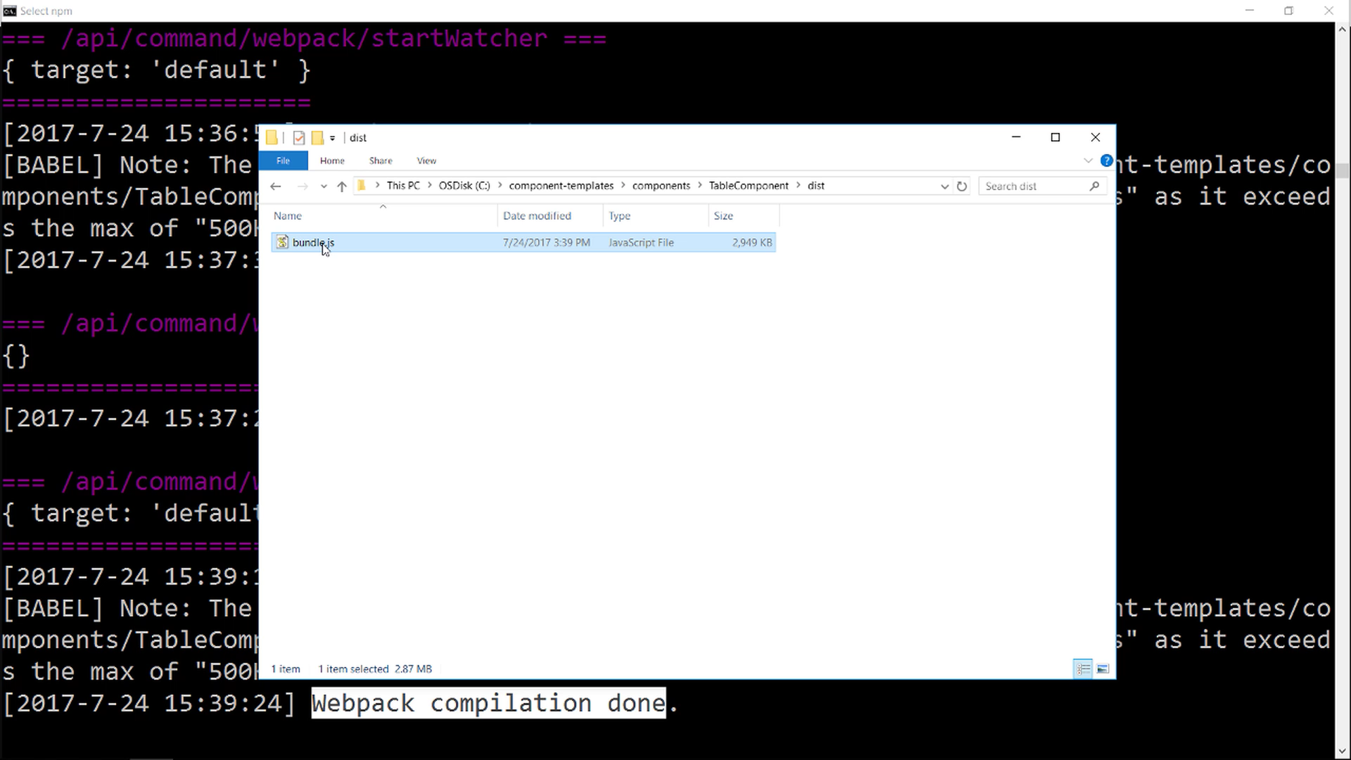
GAIA - Webpack Plugin

Slide 12
GAIA - Millennium Proxy
Allows Gaia to connect to a Millennium domain through a URL.
Can execute arbitrary CCL programs.

Slide 13
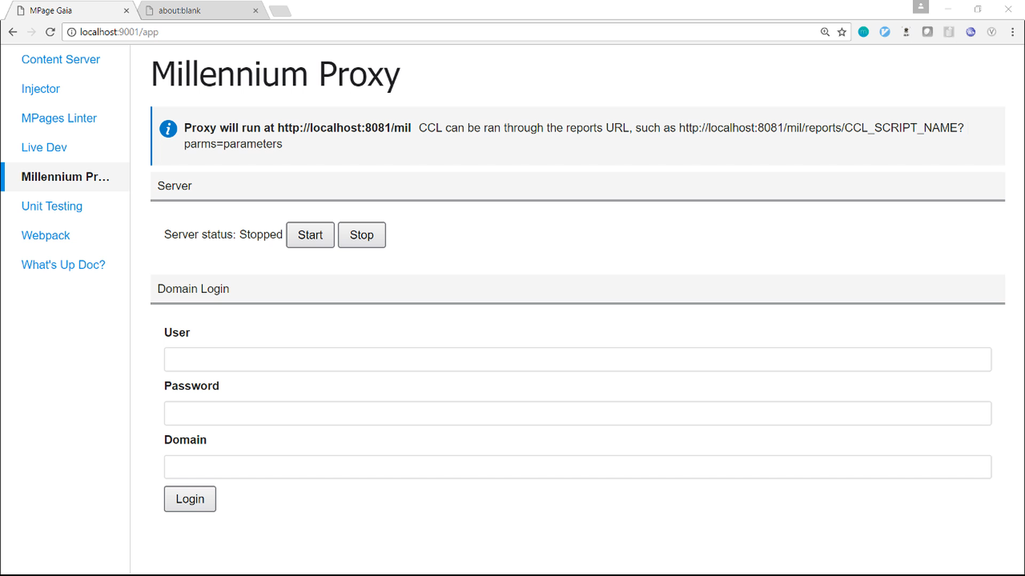
GAIA - Millennium Proxy

Slide 14
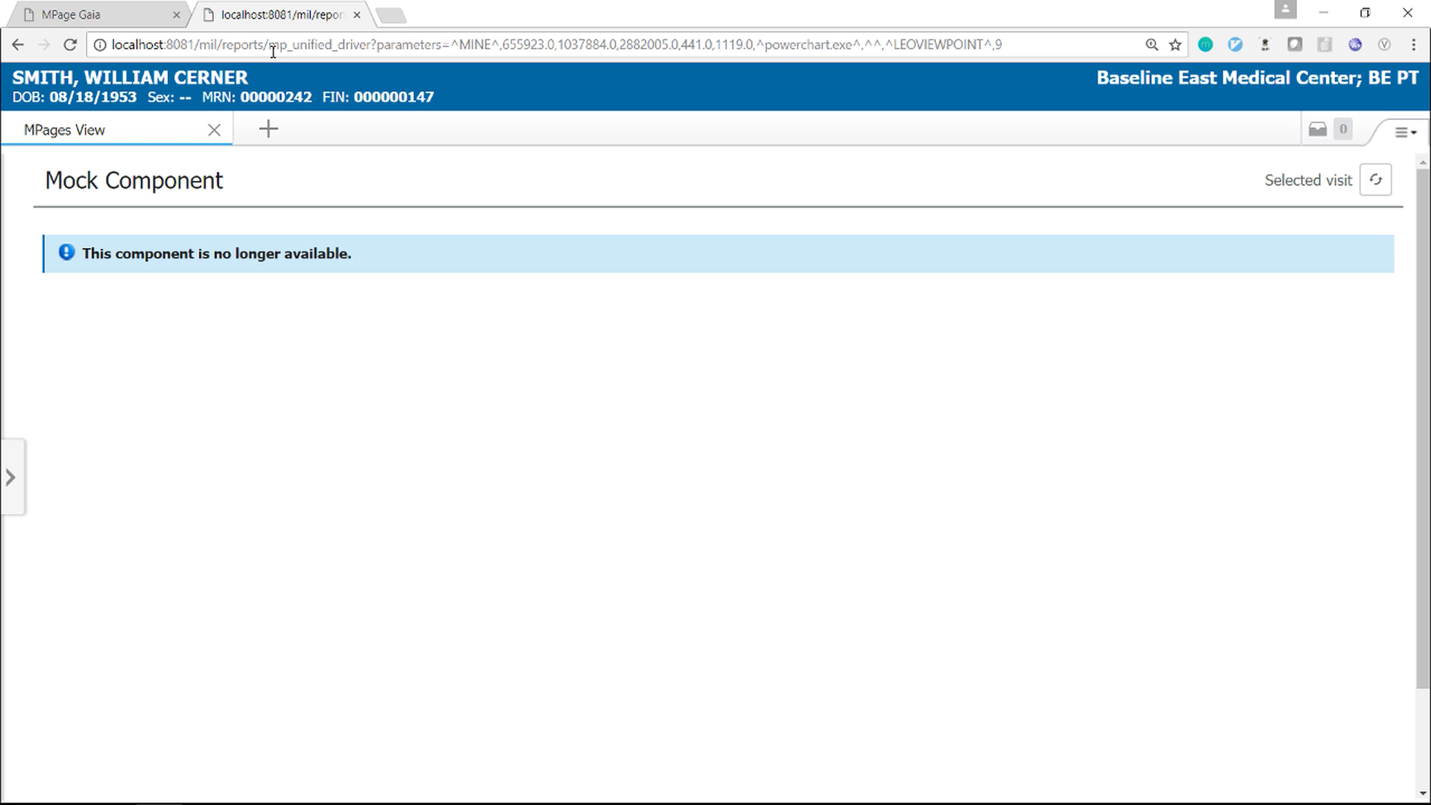
GAIA - Millennium Proxy

Slide 15


GAIA - Injector Plugin
Allows injecting custom scripts into existing HTTP calls.
<html>
<head>
<title>My Page</title>
</head>
<body>
...
</body>
</html>
MPage
Browser
Millennium Proxy

Slide 16
GAIA - Injector Plugin
JS file is injected into the HTML page.
<html>
<head>
<title>My Page</title>
<script src="myInjectedScript.js" type="text/javascript"></script>
</head>
<body>
...
</body>
</html>

Slide 17
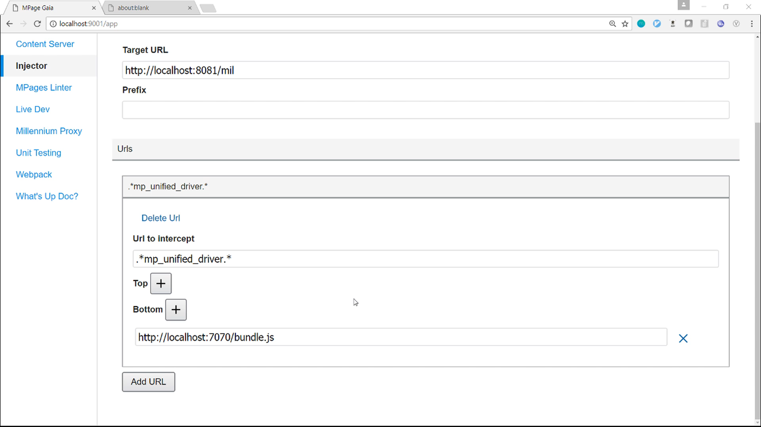
GAIA - Injector Plugin

Slide 18
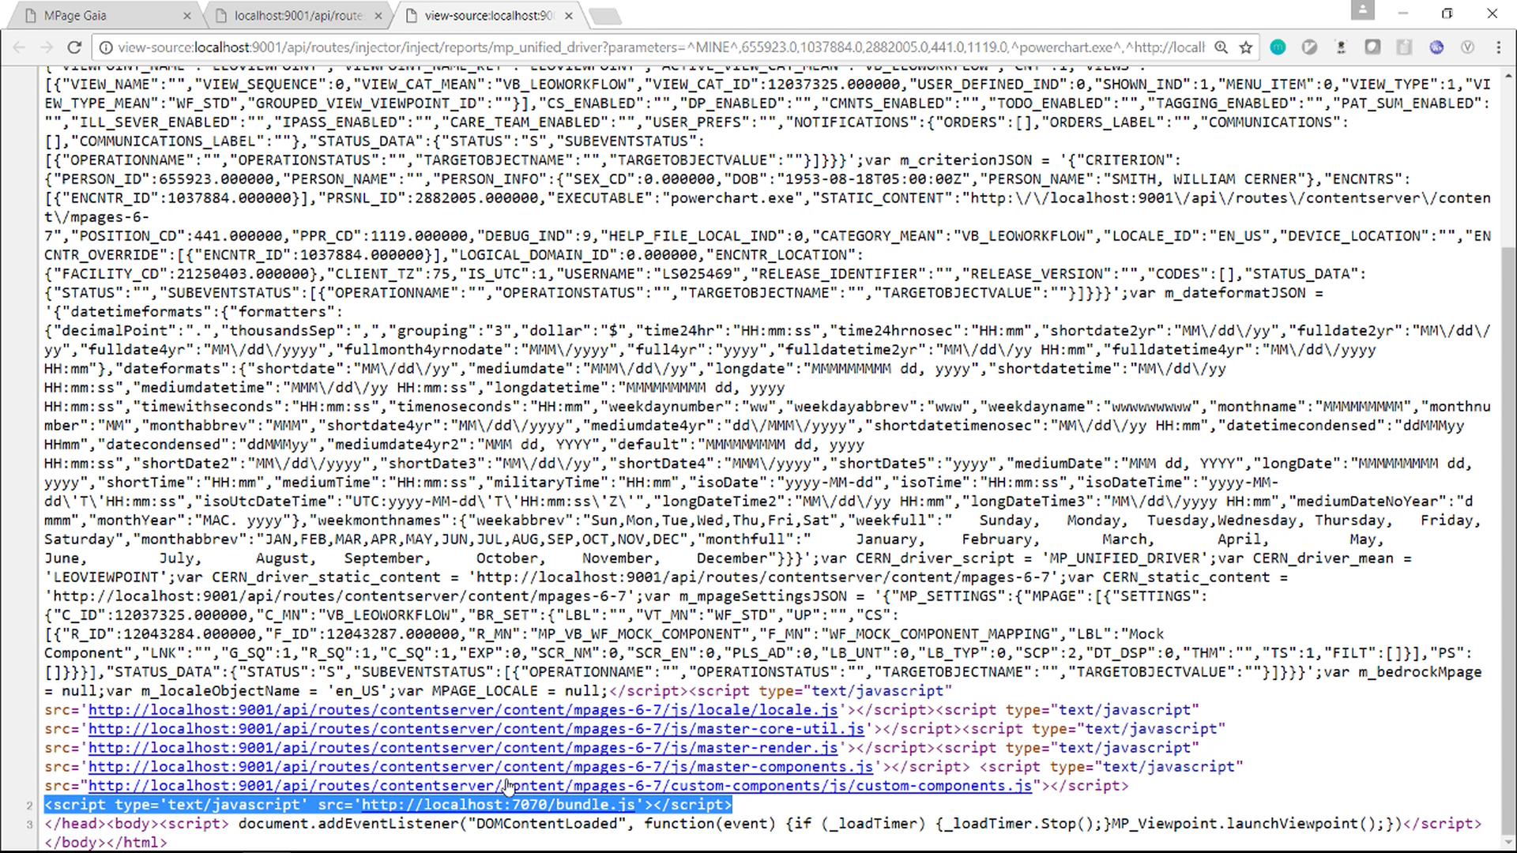
GAIA - Injector Plugin

Slide 19
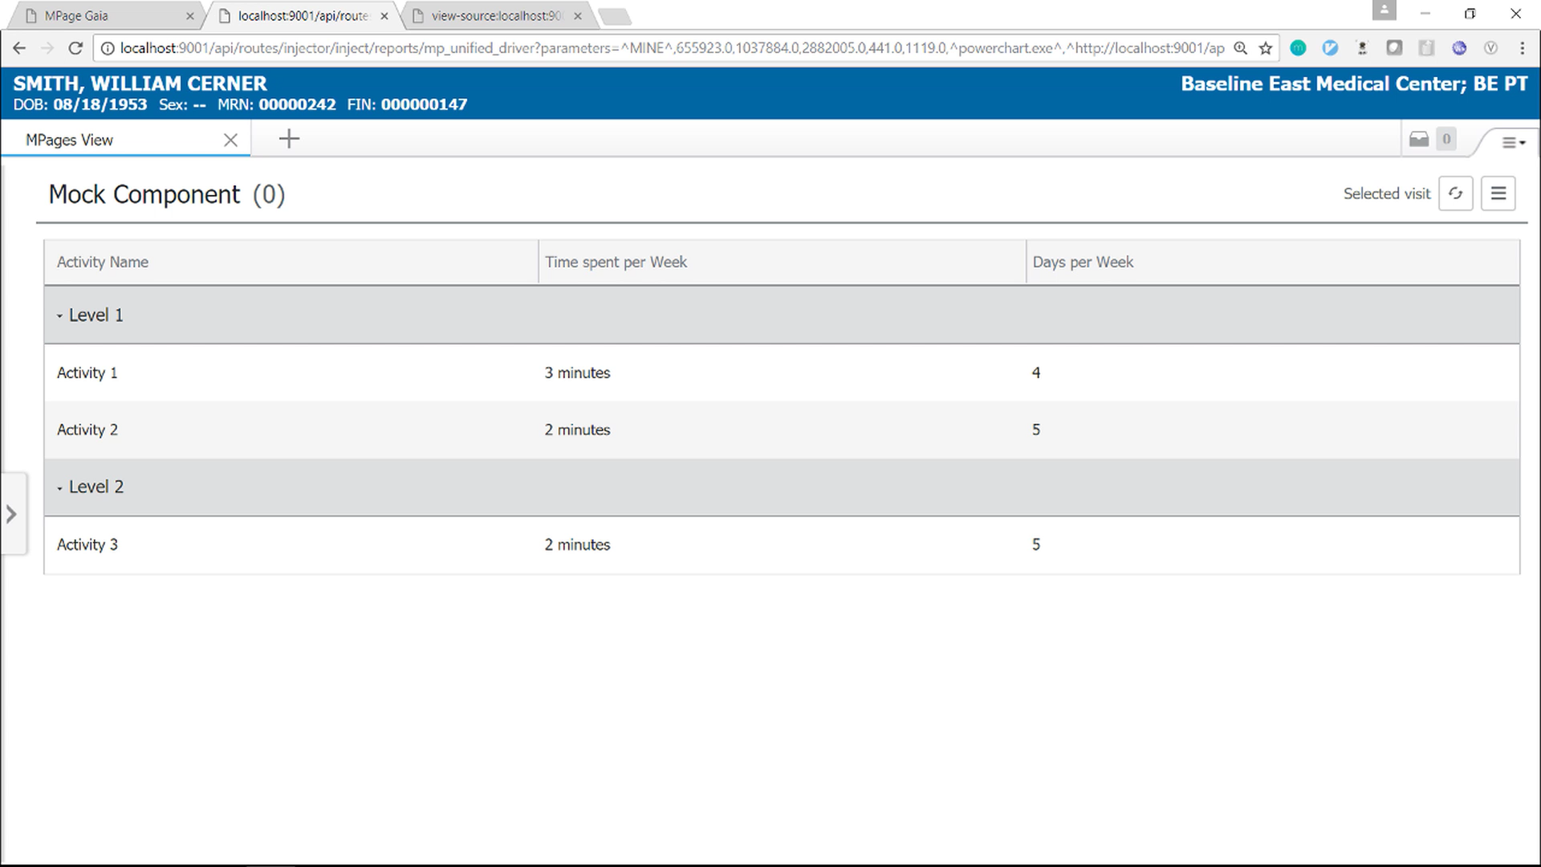
GAIA - Injector Plugin

Slide 20
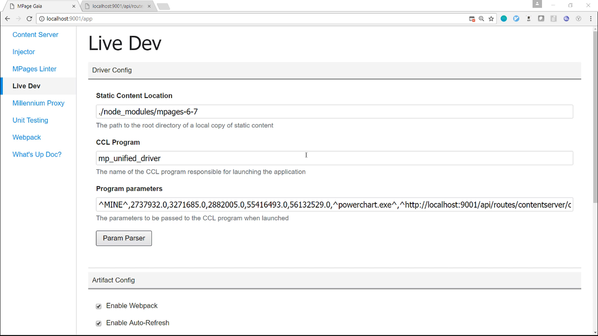
GAIA - Live Dev Plugin
Configures the injector and millennium proxy.
Allows launching an injected MPage with minimum effort.

Slide 21
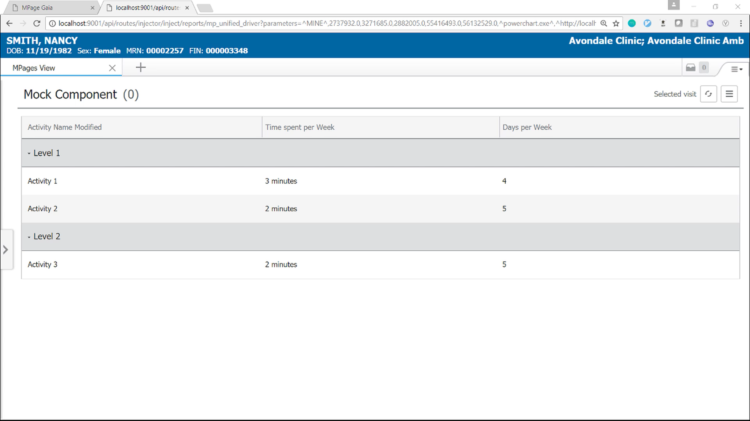
GAIA - Live Dev Plugin

Slide 22
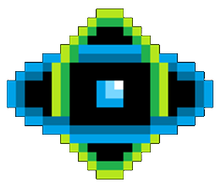
MPages Fusion

Slide 23
MPages Fusion
What is it?
MPages Fusion is a Code Companion Library of reusable UI elements that are inherently responsive and aligned with One Cerner Style.
Who should use Fusion?
All Cerner and Client Engineers should use Fusion for MPages Development
Guiding Principles
Consistent
Responsive
Fast
Integrates easily

Slide 24
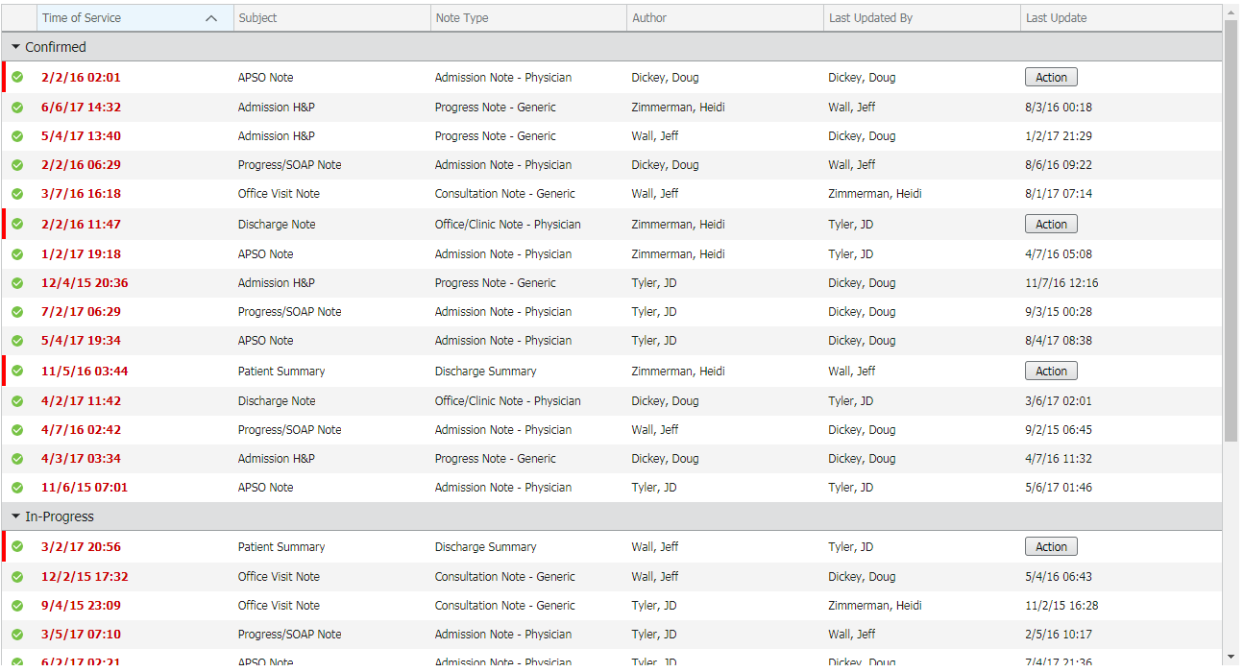
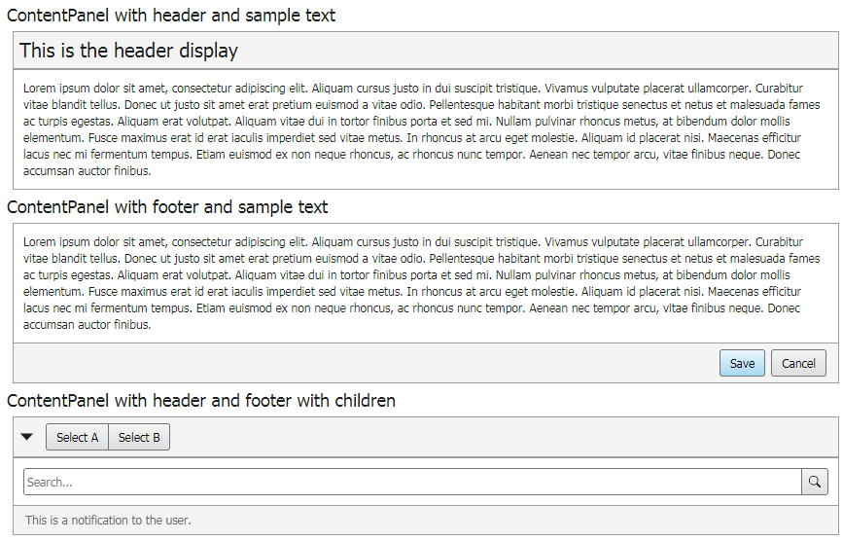
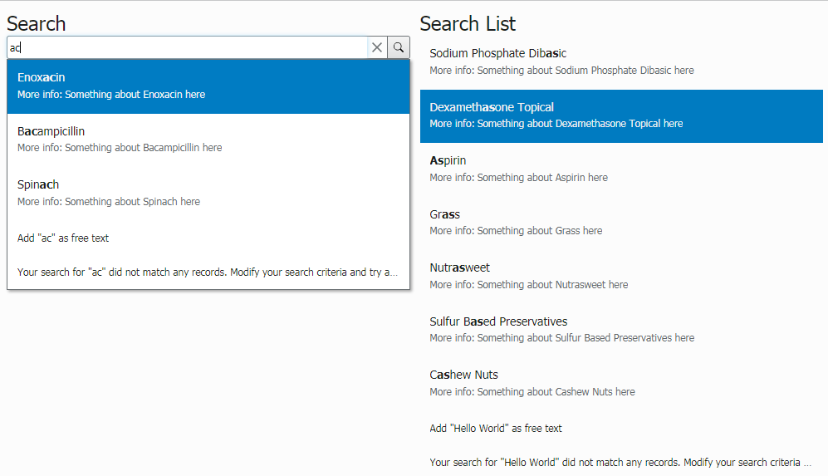
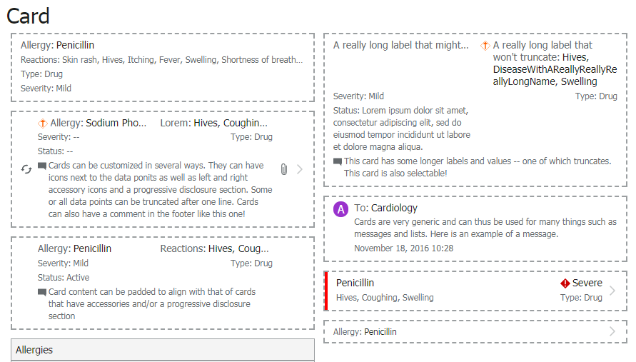
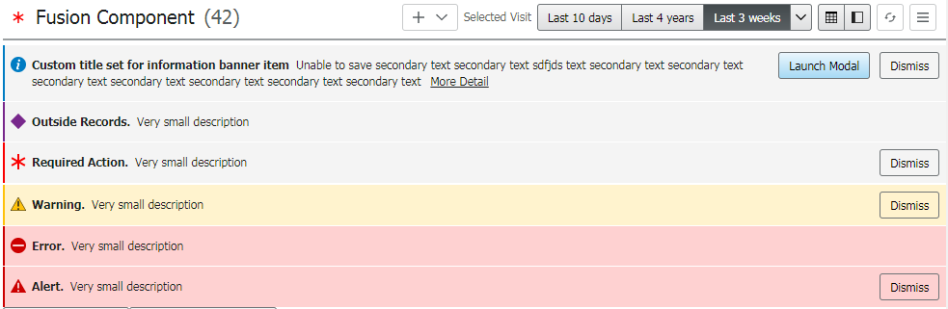
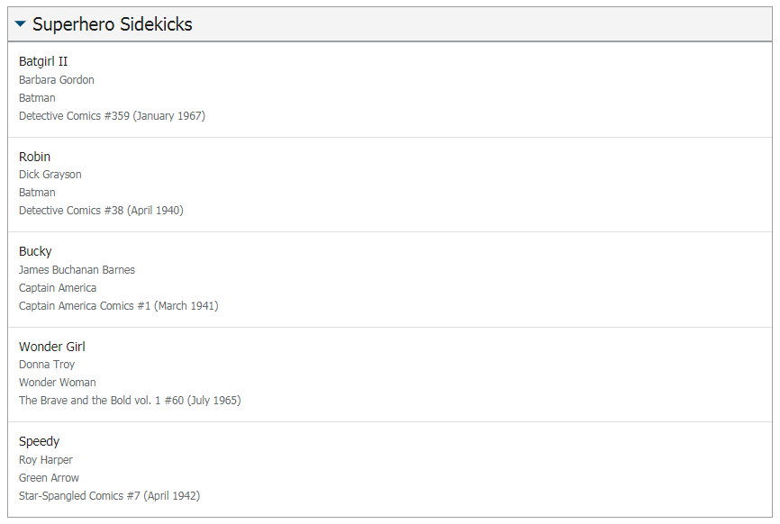
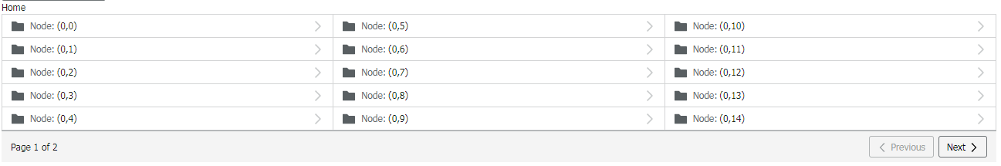
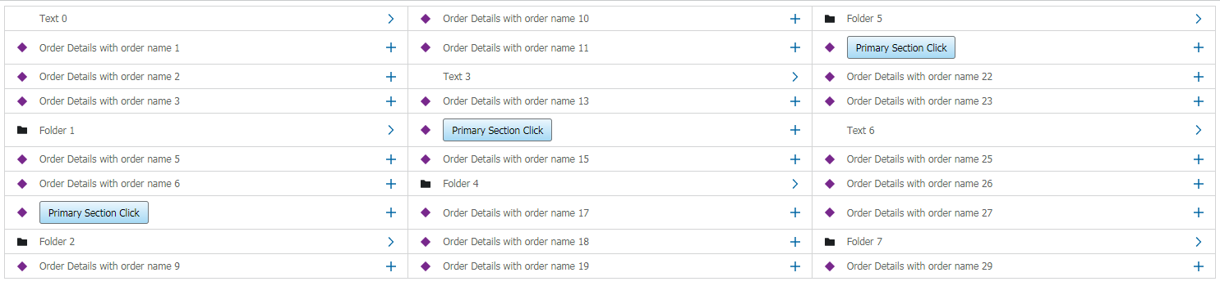
MPages Fusion
Reusable UI controls that can be updated centrally to ensure a consistent user experience.

Slide 25
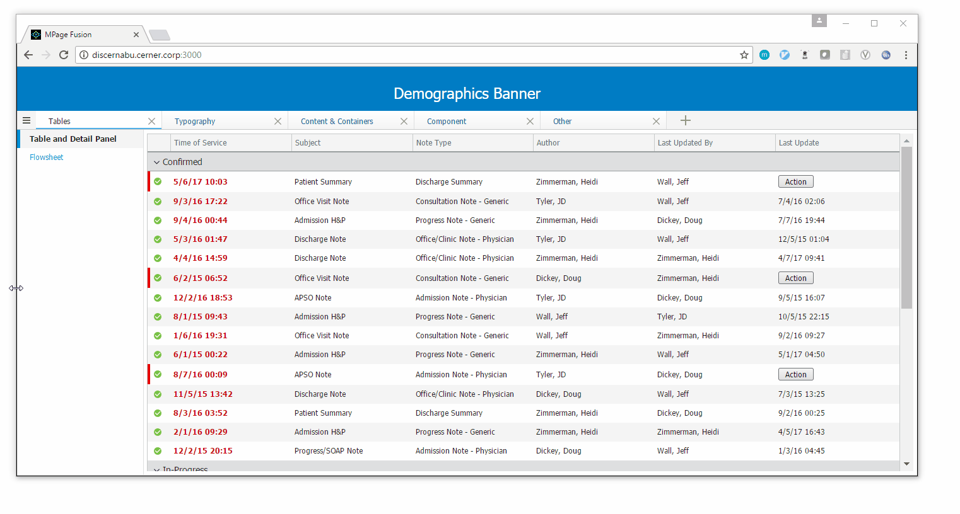
MPages Fusion
All controls are responsive and adapt to the device and screen size being used.

Slide 26
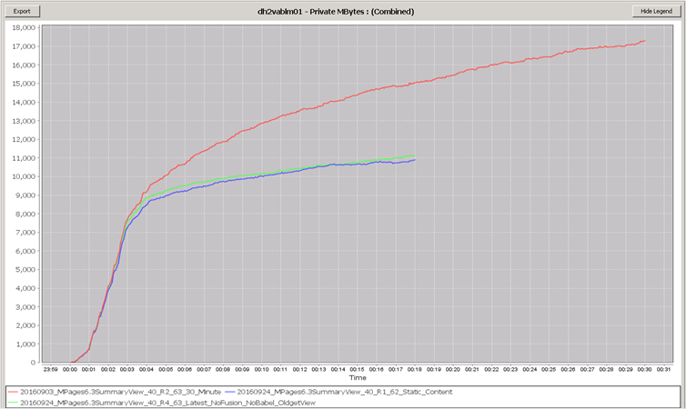
MPages Fusion
All Fusion elements and implementations are performance tested and validated in the Abilities Lab to ensure optimized performance.

Slide 27
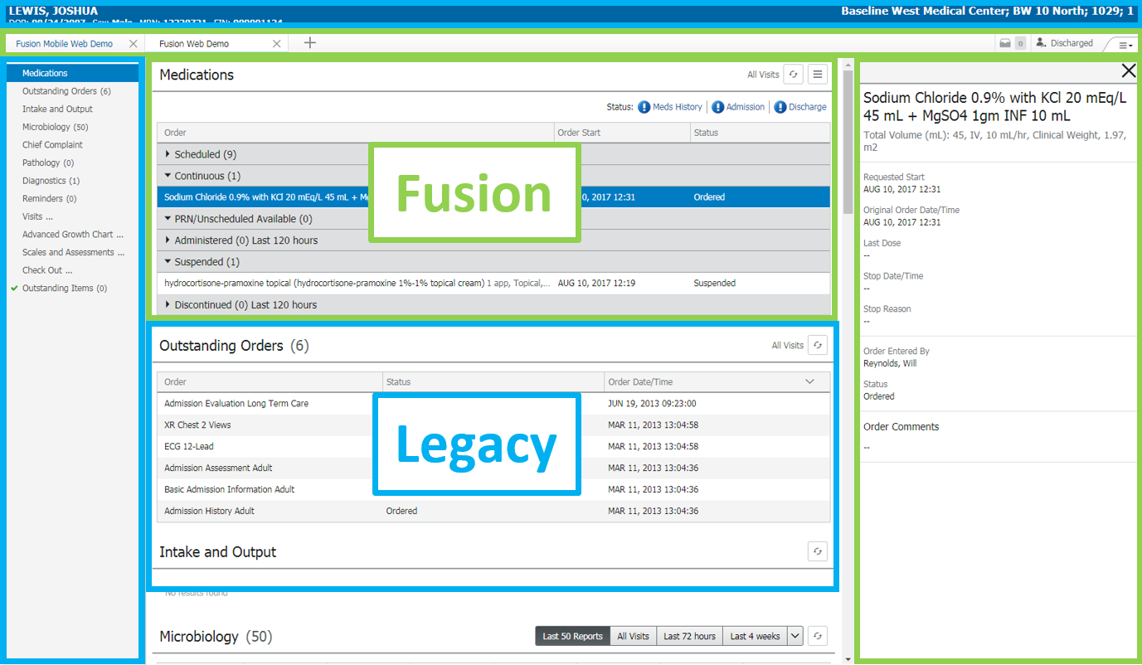
MPages Fusion
Easily integrates within an existing application. No complete rewrite and provides a path for migration.

Slide 28
MPages Fusion
Full API documentation
User guides

